Slide 1
ONLINE FOOD DELIVERY TEAM-6
FRONT-END
Narikimilli Sai Sandeep
Pasala Siva Krishna
Pachipalem Mounika
Nallamothu harshika
Niraj Gupta
BACK-END
Niranjan J
Pedapatnam Yaswanth Vinay
Pavan P S
Prabhat Kumar Sahu
Neelu X
Palepu Achyuth Varma

Slide 2
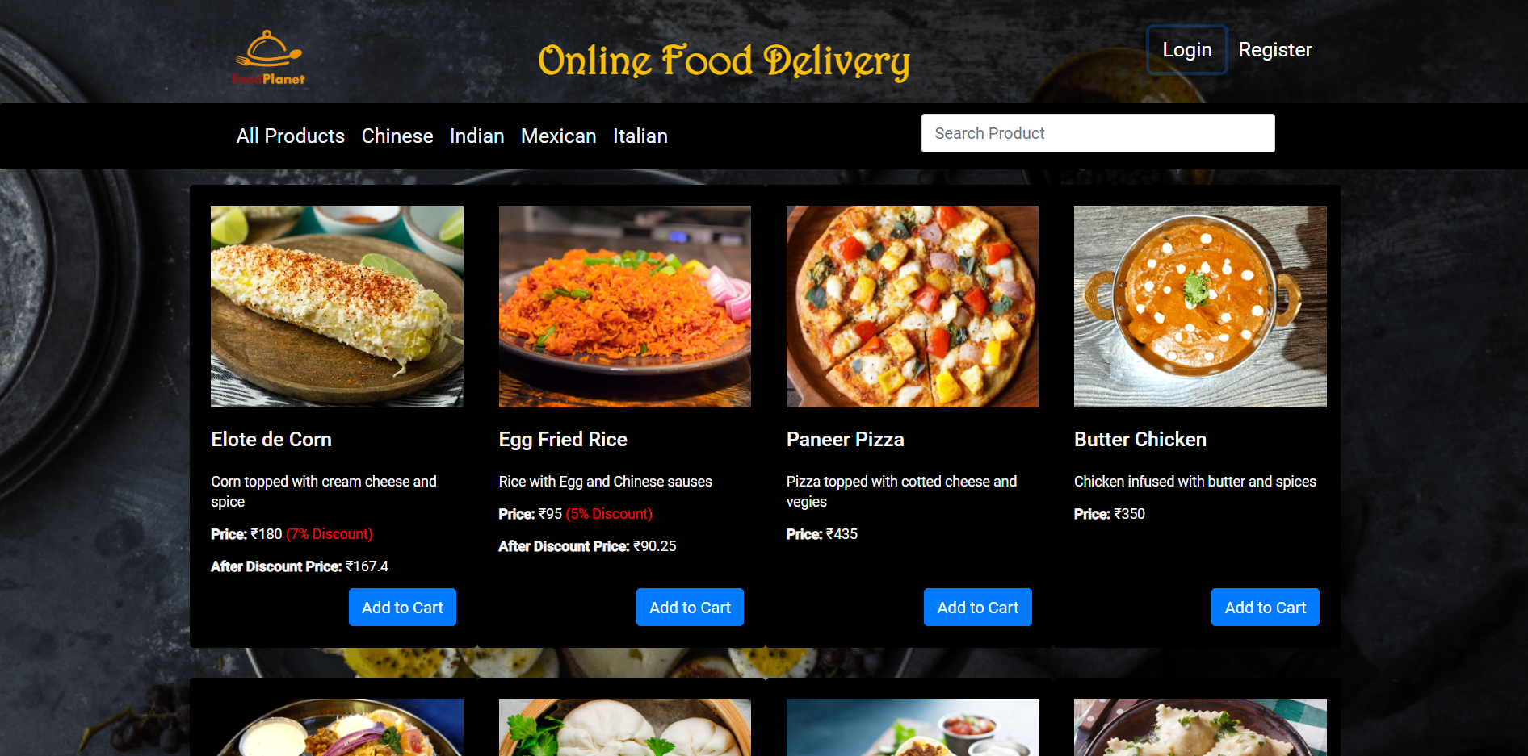
ONLINE FOOD DELIVERY

Slide 3
CONTENTS
Introduction
Objectives
Tools & L
System Requirements
Existing system
Proposed System
Modules In Project
UML Diagram
App Flow
Advantages
Spring MVC Pattern
Scope & Improvements
Conclusion

Slide 4
Introduction
ONLINE FOOD DELIVERY SYSTEM is mainly designed as primary function for use in the food delivery industry.
This system will allow hotels and restaurants to increase online food ordering such type of business.
It typically allows customers to choose and pay for food, then alerts the kitchen when an order is made. This happens without contact between staff and customers
Modern food industries allows quickly and easily to delivery food on customer place.

Slide 5
OBJECTIVES
The main objective of the Online Food Delivery System is to manage the details of Product, Delivery Address, Order, Shopping Cart.
Practically : The system is quite stable and can be operated by the people with average intelligence
Efficiency : We tried to involve accuracy, timeliness and comprehensiveness of system output.

Slide 6
TOOLS & SOFTWARE
TOOLS
TECHNOLOGY
SPRING BOOT
HIBERNATE
MY SQL
HTML
CSS
BOOTSTRAP
ANGULAR
SPRING TOOL SUITE
VISUAL STUDIO CODE
POSTMAN
MY SQL WORKBENCH

Slide 7
SYSTEM REQUIREMENTS
The Basic System Requirements for Running this project are listed below:
Angular, STS and MySQL to be installed in the system
Microsoft Windows XP or Linux or Equivalent OS
Web Browser Internet Explorer Version 10

Slide 8
PROPOSED SYSTEM
Our proposed System helps to make food ordering simple and to deliver food at the doorstep.
Customers can choose their favorite food ,order and make payments online.
This system helps to reduce the time of customers and get Quality foods on time.

Slide 9
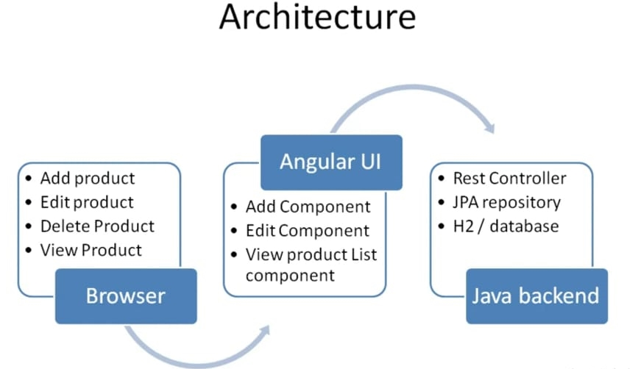
APP FLOW

Slide 10
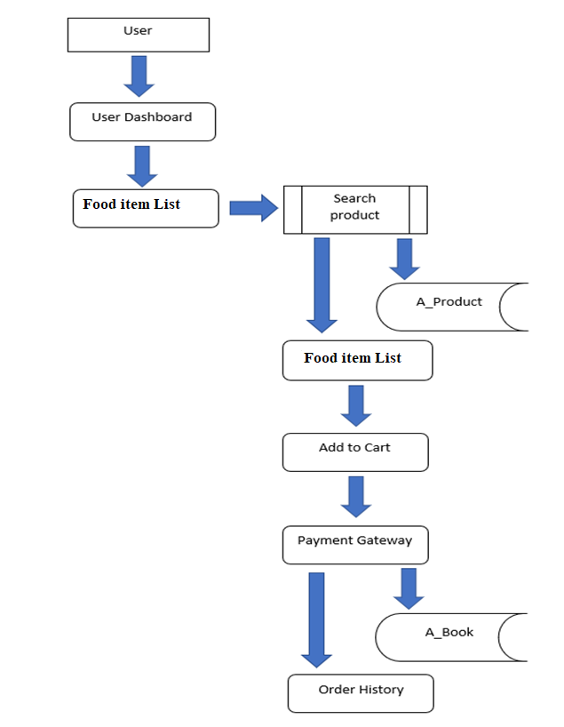
UML DIAGRAM

Slide 11
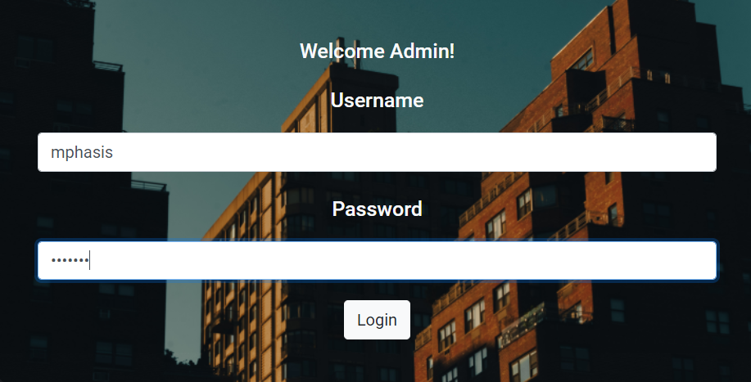
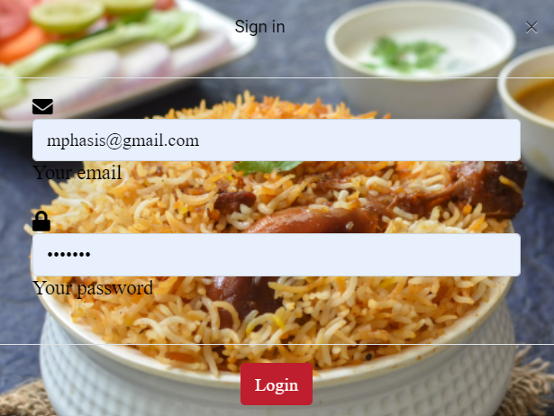
ADMIN &CUSTOMER LOGIN

Slide 12
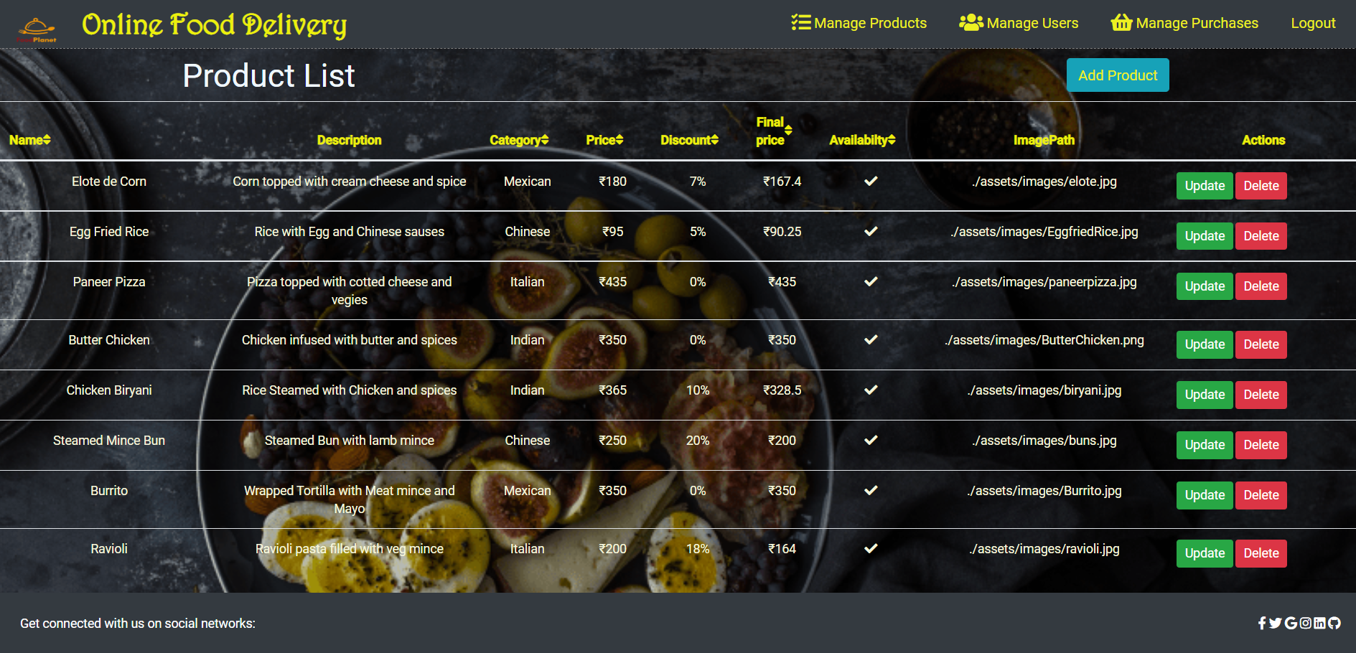
ADMIN DASHBOARD

Slide 13
ADVANTAGES
Makes the ordering process easier.
Efficient customer and order management.
Monitor your expenses incurred in real-time.
Free and cheap marketing.
Better customers data.
The convenience of mobile ordering.
Stay ahead of the competition.
Greater reach.

Slide 14
SCOPE
The Scope of the project (Android / web panel based application) are as follows:
Food Ordering app can sale Food product, preferred brands, kitchen needs, essential restaurant supplies and more, through this online, one- stop Food store.
It provides you with a convenient way to sale from your Food shopping app.

Slide 15
CONCLUSION
An Online Food Ordering System is proposed here which simplifies the food ordering process.
The proposed system shows an user interface and update the menu with all available options so that it eases the customer work.

